Slide 1
Build tools
For java app : Maven jar/rar/war
For dotnet : Nuget pakege manger / MSBuild (Visual studio build)
Python : pybuild
NodeJS NPM

Slide 2
Apache Maven
Apache Maven is a software project management and comprehension tool. Based on the concept of a project object model (POM), Maven can manage a project's build, ,maven we can build and manage any java based project.
Maven provides developers ways to manage the following:
• Builds
• Documentation
• Reporting
• Dependencies
• SCMs
• Releases
• Distribution
• Mailing list

Slide 3
Installation
Step1: Downalod and install java
Step 2 : setup env variables and system / variables

Slide 4
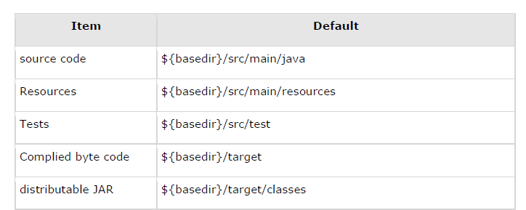
Convention over Configuration
Maven uses Convention over Configuration, which means developers are not required to create build process themselves.
Developers do not have to mention each and every configuration detail. Maven provides sensible default behavior for projects.
When a Maven project is created, Maven creates default project structure. Developer is only required to place files accordingly and he/she need not to define any configuration in pom.xml.

Slide 5
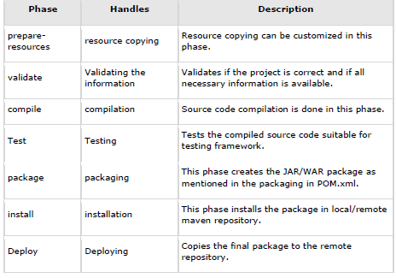
What is Build Lifecycle?
A Build Lifecycle is a well-defined sequence of phases, which define the order in which the goals are to be executed. Here phase represents a stage in life cycle.

Slide 6
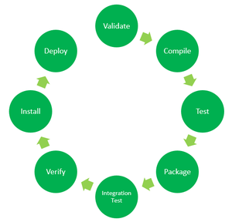
Maven has the following three standard lifecycles:
• clean
• default(or build)
• site

Slide 7
